Slide 1
Inpatient Survey 2023: multilevel modelling of demographic data
SE Performance Analysis Team
Presented by: Neil Jackson
Notes:
Standard title slide

Slide 2
Background
Survey of all acute trusts in England
>40 questions, responses from 0 (worst) to 10 (best)
We have mean score for each question for each trust
We also have breakdown of respondents in each trust by various demographic characteristics
However we don’t have responses by characteristic
Challenge is to understand how each trust is performing, allowing for demographic makeup of respondents
Notes:
Plain slide with subhead and bullets

Slide 3
Methodology
Treat each mean score for each trust as a single observation
Scores within the same trust are likely to be correlated
This can be accounted for by using a multilevel, or mixed effects, model:
Level 1 (observations): each individual question score
Level 2 (groups): the trusts
Notes:
Plain slide with subhead and bullets

Slide 4
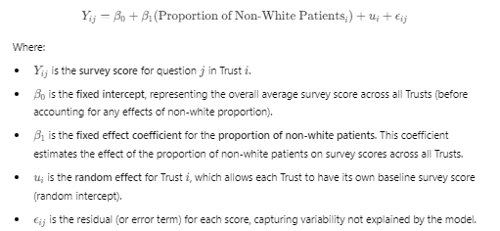
Model specification
In the example where we are looking at the proportion of non-white patients, the form of the model would be as follows:
The random effect (intercept) for each trust will give us an indication of how its survey scores differ from the national average, accounting for its demographic makeup
Notes:
Plain slide with subhead and bullets

Slide 5
Characteristics available for analysis
The following characteristics were available for analysis:
Age
Disability
Ethnicity
Long-term condition
Gender same as sex at birth
Religion
Sexuality
Admission route (elective or emergency)
Sex at birth
Notes:
Plain slide with subhead and bullets

Slide 6
Choice of independent variables (1)
I looked at the linear correlation between each demographic variable and the mean scores, using the CORREL function in Excel which calculates the Pearson correlation coefficient
The limitations of this method are that it assumes a linear relationship, and does not account for interactions between variables
All correlations were extremely weak, with only two having an absolute value over 0.1:
Age 51-65 +0.12
Emergency admission -0.15
In total,18 variables had a correlation with an absolute value greater than 0.05
Disability and long-term condition had no variables with a correlation above this level, so were not considered
As it has the strongest correlation, emergency admission was considered despite not being a demographic variable
Notes:
Plain slide with subhead and bullets

Slide 7
Choice of independent variables (2)
A number of calculated variables were also created, all of which had an absolute correlation greater than 0.05:
Non-white ethnicity (excluding ethnicity not stated)
Non-Christian religion (excluding not stated, as well as Christian and no religion)
Any religion (as above, but including Christian)
In addition, several models with multiple variables were tested:
Model using ages 51-65 and 66+ (and their interactions) produced significant effects
No significant effects were found for any models using multiple ethnicity or religion variables
The best model combining different demographic variables used age 66+ and non-white ethnicity (interactions were not significant in this case)
Religion was not included in this model as it is highly correlated with ethnicity
Notes:
Plain slide with subhead and bullets

Slide 8
Comparing trusts
The random intercept for each trust in any given model gives an indication of how well that trust performed in the survey, controlling for the variable(s) in the model
For the best model for each demographic characteristic, all trusts were ranked by their intercept. These were then summed to produce an overall ranking
The four trusts of most concern in the South East (Dartford & Gravesham,East Kent, Medway and Portsmouth) were all ranked in the bottom 11 of 131 trusts nationally overall, and none were ranked above 100 for any of the models. This suggests that none of the characteristics considered explain the poor performance of any of these trusts
Of the characteristics not collected in the survey, deprivation seems most likely to have had an effect on performance
Notes:
Plain slide with subhead and bullets

